Slide 1
Advanced Machine Learning
BY
Adnan Amin
http://geoamins.com

Slide 2
RECAP: Statistical Perspective of Machine Learning
Statistical Perspective:
The machine learning algorithm aims to learn a hypothetical function f( )
Given some input variables f( input )
The hypothetical function predicted the output variable Output
f(input) → output
Machine learning algorithms are described as learning a target function (f) that best maps input variables (X) to an output variable (Y).
f(X)→Y
This is a general learning task where we would like to make predictions in the future (Y) given new examples of input variables (X).
f(IndependentVariables)→ DependentVariable
Computer Science Perspective:
Prediction = Program(Instance)

Slide 3
Learning a Function
f(X)=Y+e
To make predictions in the future (Y) given new examples of input variables (X), There is also error e that is independent of the input data (X).
This error might be an error such as not having enough attributes to sufficiently characterize the best mapping from X to Y.

Slide 4
Parameter vs Hyperparameter:
A parameter can be described as a configuration variable that is essential to the model.
Model parameters are usually not set manually.
The value of a parameter can be approximated from the training data in consideration.
Hyperparameters are configuration variables that are external to the model.
hyperparameters are manually set.

Slide 5
Parametric (P) and Nonparametric (Non-P)
All learning algorithms are categorized into P and Non-P.
P algorithms simplify the mapping to a known functional form.
Non-P algorithms can learn any mapping from inputs to outputs.

Slide 6
1. Parametric ML Algorithms
“A learning model that summarizes data with a set of parameters of fixed size (independent of the number of training examples) is called a parametric model.
No matter how much data you throw at a parametric model, it won’t change its mind about how many parameters it needs.”
— Artificial Intelligence: A Modern Approach, page 737
E.g., :
Linear Regression
Linear SVM
Logistic Regression
Perception

Slide 7
2. Non-parametric ML Algorithms
Algorithms that do not make strong assumptions about the form of the mapping function are called nonparametric machine learning algorithms.
By not making assumptions, they are free to learn any functional form from the training data.
E.g.,
Naïve bayes
Decision Tree
SVM
Neural Network

Slide 8
Types of Data
Qualitative Data (Quality)
Quantitative Data (Quantity)
Categorical
Numerical
Notes:
Numerical: represents some sort of quantitative measurement

Slide 9
Types of Data
Structured data
Refers to highly organized information that can be seamlessly included in a database and readily searched via simple search operations.
E.g., numbers (age, income, height, weight etc.)
Text (name, address, comments etc.)
Boolean (is_married, is_employed)
Categorical data (gender, marital_status)
Unstructured data
Lacking any underlying structure.
E.g., Multimedia data (audio, video, images etc.)
Email, social media post, youtube video

Slide 10
How to handle category data (problems)
We can use encoding.
This is the process by which we convert a categorical variable into a numerical form.
There are three methods for encoding the categorical data.
Replacing
Label encoding
One-hot encoding
Notes:
Replacing method Replace the categorical data with a number.

Slide 11
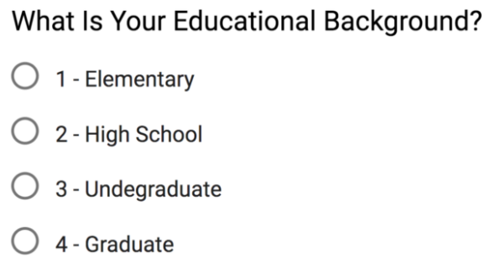
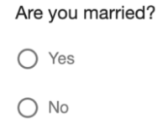
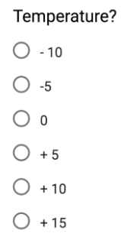
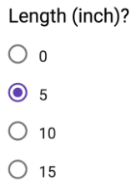

Types of Data
Qualitative Data (Quality)
Quantitative Data (Quantity)
Categorical
Numerical
Nominal
Discrete
Continuous
Ordinal
Binary
Interval
Ratio
Nominal
Ordinal
No, order
e.g. Labels
order
Gender
1: Female
2: Male
can’t be measured but it can be counted.
don’t have a “true zero“
have an absolute zero
can’t be counted but they can be measured
Categorical data that has mathematical meaning
Ratings 1,2,3,4 or 5 (1 means worse, 5 best)
Notes:
For examples:
Numerical: heights of people, page load times, stock prices,
Discrete Data (integer based, often counts of some events)
e.g., how many purchases did a customer make in a year
how many times did I Flip “heads”?
Continuous Data (has an infinite number of possible values)
e.g., how much time did it take for a user to check out?
how much rain fell on a given day?
Categorical
-------------
Qualitative data that has no inherent mathematical meaning
e.g., Gender, Yes/No (binary data), Race, State of Residence, Product Category, Political Party,
You can assign numbers to categories in order to represent them more compactly, but the numbers don’t have mathematical meaning

Slide 12
Data Collections
Data can be read directly from a file, or they might be obtained by scraping or crawling the web.
Data collection techniques:
Open data
Survey data
Observational data
Experimental data

Slide 13
1. Survey
A survey typically (but not always) collects data by asking questions (in person or by phone) or providing questionnaires to study participants (as a printout or online).
Ideally, a survey is conducted in a way which makes the chosen sample representative of the population of interest.

Slide 14
2. Experiment’s data
Experimental data is obtained in “controlled” settings. This can mean many things, but essentially it is data which is generated by the researcher with full control over one or many variables of interest.
For example:
suppose there are two competing toothpastes, both of which promise to reduce pain for people with sensitive teeth. If the researcher decided to randomly assign toothpaste A to half of the study participants, and toothpaste B to the other half, then this is an experiment because it is only the researcher who decides which toothpaste is to be used by any of the participants. It is not decided by the participant.

Slide 15
3. Observational Data
Observational data is data which is collected routinely, without a researcher designing a survey or conducting an experiment.
For example:
Suppose a blood sample is drawn from each patient with a particular acute infection when they arrive at a hospital. This data may be stored in the hospital’s folders and later accessed by a researcher who is interested in studying this infection.

Slide 16
4. Primary and Secondary Data.
Primary data is data we collect ourselves, i.e. via a survey or experiment.
Secondary data, in contrast, is collected by someone else.
For example:
data from a national census, publicly available databases, previous research studies, government reports, historical data, and data from the internet, among others, are secondary data.

Slide 17




Creating a Data Set
The data is stored in a data matrix (=data set) with p columns and n rows.
Each row corresponds to an observation/unit ω and each column to a variable X.
Data matrix Data set of marks of ﬁve students
Coding list for branch

Slide 18
Data Transformations
Representation of the data in more appropriate form for mining process, easier to understand, consolidated form etc.
For example:
we have captured the temperature in degrees Celsius, whereas we need to communicate results in degrees Fahrenheit.
we may have captured the velocity of cars in kilometers per hour, but may need to present the data in miles per hour.
we have created a satisfaction score which we want to range from 5 to + 5, while the score currently runs from 0 to 20.

Slide 19
Strategies for Data Transformation
Smoothing (remove noise)
Attribute construction (adding new feature)
Aggregation (summarize form, data cube)
Normalization
Where attribute data are scaled and fall within smaller range such as: -1.0 to 1.0 or 0.0 to 1.0
Discretization
E.g., age {0-10, 11-20 etc.} or {young, adult, old}
Formula for transformation of interval and ratio scaled variable

Slide 20
1. Transformation Formula
The temperature in ◦F relates to the temperature in ◦C as follows:
Temperature in ◦F = 32 + 1.8 Temperature in ◦C
g(x ) = a + b x
This means that 25 ◦C relates to (32 + 1.8 · 25) ◦F = 77 ◦
Interval Scale variable:
g(x ) = a + bx, b > 0.
Ration Scale variable:
g(x ) = bx, b > 0.
Changing currencies is also possible. If we would like to represent the price of a product not in Pakistani rupee but in $, we simply apply the transformation Price in Pakistani PKR
= b · Price in $
whereby b is the currency exchange rate.

Slide 21
2. Smoothing by Binning method
Binning methods smooth a sorted data by considering neighborhood, the values around it. Then sorted values are distributed into number of buckets or bins.
There are two methods:
Smoothing by bin means
Each value in a bin is replaced by the mean value of the bin.
Smoothing by bin medians
It can be employed, in which each bin value is replaced by the bin median.
Smoothing by bin boundaries
The min & max values in a given bin are identified as the bin boundaries. Each bin value is then replaced by the closest boundary value.

Slide 22
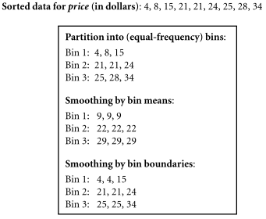
Example: Binning method for data smoothing

Slide 23
3. Normalization
There are many methods for data normalization such as:
Min-Max normalization
Minimum and maximum values must be known
Cannot use handle outlier if exist in min or max value
Z-score normalization
If min & max values are unknown.
If there is outlier that dominate the min-max norms.

Slide 24
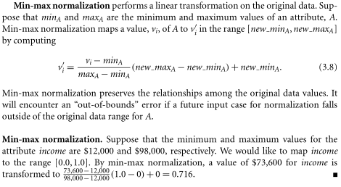
3.1. Min-Max Normalization
let A be a numeric attribute with n observed values, V1 ,V2 ,...,Vn .

Slide 25
3.1. Min-Max normalization cont.

Slide 26
4. Discretization
Univariate analysis explores variables (attributes) one by one.
Discretization by binning
Unsupervised binning method:
Unsupervised binning methods transform numerical variables into categorical counterparts but do not use the target (class) information.
e.g., equal-width or equal-frequency (bin means, median)
Supervised binning method:
transform numerical variables into categorical counterparts and refer to the target (class) information when selecting discretization cut points.
Entropy-based binning is an example of a supervised binning method.
Discretization by histogram analysis
Unsupervised discretization technique

Slide 27
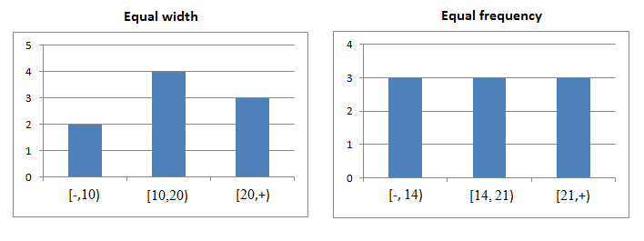
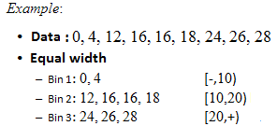
4.1. Equal Width Binning
The algorithm divides the data into k intervals of equal size.
The best way of determining k value is by looking at the histogram

Slide 28
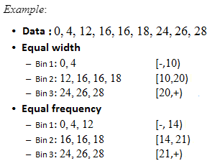
4.2. Equal Frequency Binning
The algorithm divides the data into k groups which each group contains approximately same number of values.

Slide 29

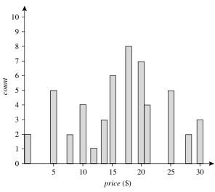
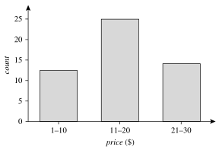
4.2. Discretization by histogram analysis

Slide 30
Handling Categorical Data
High cardinality
Cardinality means uniqueness in data. The data column, in this case, will have a lot of different values. E.g., User_ID
Rare occurrences
These data columns might have variables that occur very rarely and therefore would not be significant enough to have an impact on the model.
Frequent occurrences
There might be a category in the data columns that occurs many times with very low variance, which would fail to make an impact on the model.
Won't fit
This categorical data, left unprocessed, won't fit our model.

Slide 31
Data Storage and Presentation
CSV (Comma-Separated Values)
TSV (Tab-Separated Values)
XML (eXtensible Markup Language)
RSS (Really Simple Syndication) – New sites, Companies news, Calender,
JSON (JavaScript Object Notation)

Slide 32
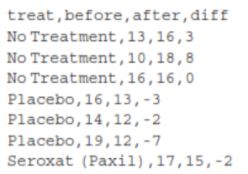
CSV

Slide 33
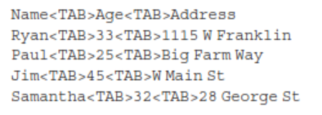
TSV

Slide 34
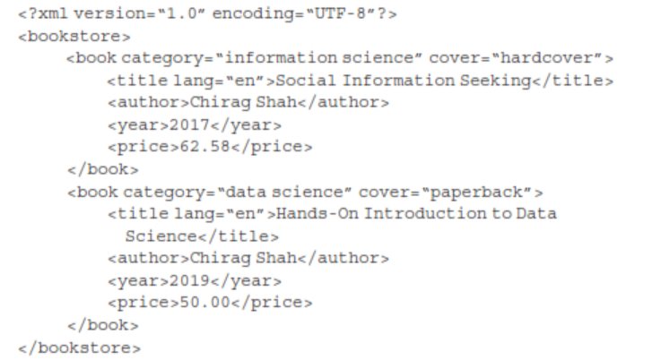
XML

Slide 35
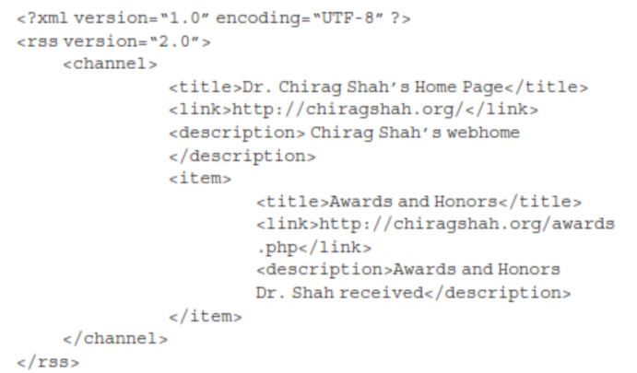
RSS

Slide 36
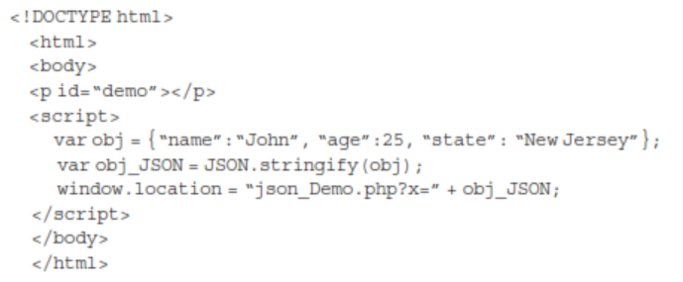
JSON

